Slide 1



Project By:
Swarneshwar -21PW25
Athmikha-21PW04
Thirusha-21PW39
Notes:
Links:
https://unsplash.com/photos/fzOITuS1DIQ

Slide 2

InBills:
In our day-to-day life we are facing many billing disputes while we are purchasing products from various stores and suppliers. Because of which we may not be able to exchange, return or keep track of the purchases and returns we did.
Apart from this, we also find difficulties in finding the best quotation for our appropriate needs such as planning a tour, AC service, architects etc.
So, it would be helpful if we are able to manage everything as a whole in a single software to solve all these disputes.
Notes:
Links:
https://www.pexels.com/photo/photo-of-men-talking-to-each-other-3285197/

Slide 3

So we as a team incentive, thought of building a software which can solve billing disputes, keep track of all the bills and to find the best service provider for all our needs.
From the business perspective, they will be able to manage all the sales and other expenses from which the software shows a complete analysis.
Various service providers can use the software to find customers for their services .
Notes:
Links:
https://unsplash.com/photos/wD1LRb9OeEo

Slide 4

BILLING DISPUTES
Billing disputes faced by the society..
Invoice processing errors
Dissatisfaction with the service
Pricing disagreements
Price conflict between various service providers
Double billing disputes
Not creating a backup of your invoices
Making it hard to pay
Notes:
Links:
https://www.pexels.com/photo/photo-of-people-looking-on-laptop-3182750/

Slide 5





With inBills,
Users can..
Have invoice backup..
Make use of credit wallets..
User can keep track of all their invoices
Credit wallets can be used incase the preferred method of payment is not available
Request Services
Select your preferred service provider
Users can request services based on their priorities
select the best service providers from the responses received
Notes:
Links:
https://www.pexels.com/photo/photo-of-people-looking-on-tablet-3182835/

Slide 6




With inBills,
Dealer can..
Generate and Backup Bills
Generate a bill for every sales , share it to customer and have a backup of till date bills
Goods info
Keep track of stocks of every product available in their store
Get Sales Analysis
Can view profit and loss in the business and overall expenses of the company for a particular period
Notes:
Links:
https://www.pexels.com/photo/photo-of-people-sitting-near-wooden-table-3183188/

Slide 7



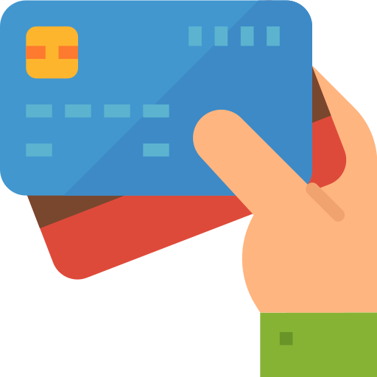
With inBills,
Contractor can..
get more customer requests
Respond to a customer’s request based on their preference.
Manage payments made by the customers
Notes:
Links:
https://www.pexels.com/photo/photo-of-person-holding-pen-3184635/

Slide 8
Project Demonstration
Notes:
Links:
https://unsplash.com/photos/fzOITuS1DIQ

Slide 9
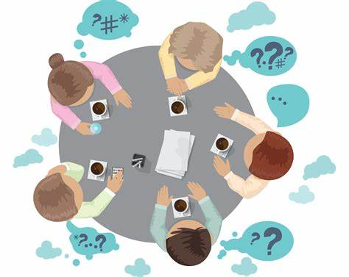


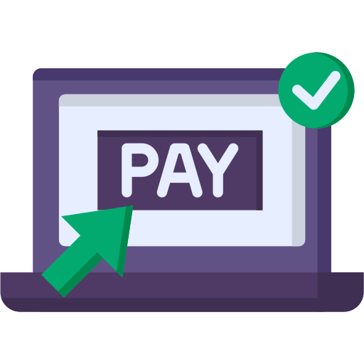


Further Enhancements:
Deletion:
Message Notification:
An option to delete unwanted bills
Notifications will be sent via WhatsApp whenever needed
Payment Gateway:
Online Orders:
Payments using gateways like GPay, PhonePe
Making online orders in different shops using make orders option
Backup & Recovery:
An option to specify the duration for backup
Notes:
Links:
https://www.pexels.com/photo/photo-of-men-talking-to-each-other-3285197/

Slide 10
THANK YOU!
Notes:
Links:
https://unsplash.com/photos/fzOITuS1DIQ

